Slide 1

PERMIT WORK SYSTEM
A comprehensive guide to understanding the functionalities in the Permit Work system.

Slide 2

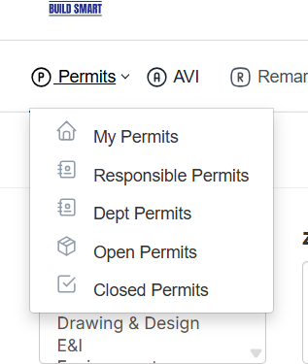

PERMITS
A Permit to Work (PTW) system is a formal, documented procedure used in workplaces—especially in high-risk industries like oil & gas, construction, and manufacturing—to control hazardous work activities. Its main purpose is to ensure safety by assessing risks and implementing necessary precautions before starting any potentially dangerous task.

Slide 3
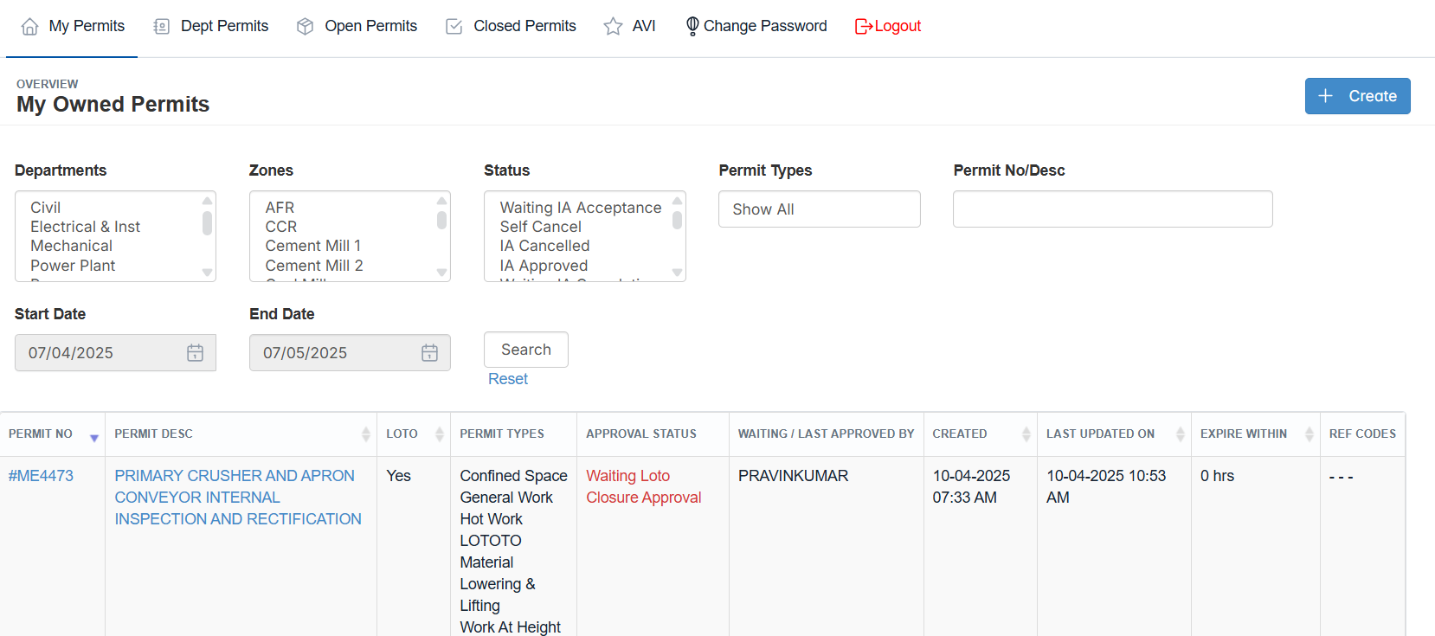
MY PERMITS
A Permit is a documented authorization that grants permission to perform specific tasks or activities under predefined safety and operational conditions. It serves as a control measure to ensure that all necessary precautions, hazard identifications, and approvals are in place before work begins, especially for high-risk or non-routine jobs.

Slide 4
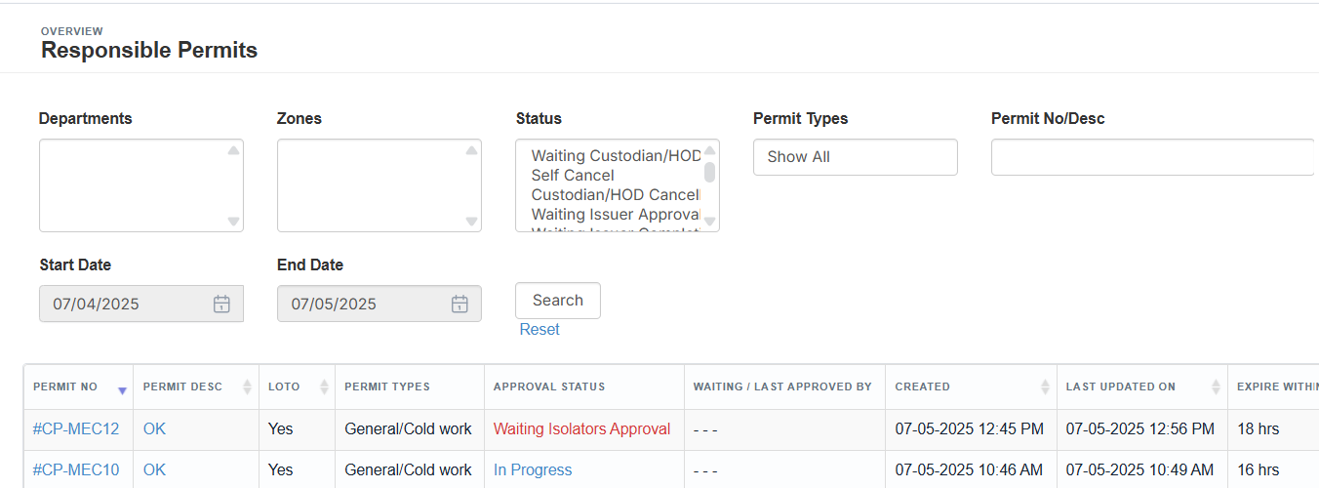
RESPONSIBLE PERMITS
A Responsible Permit refers to a work permit issued under the supervision of a designated responsible person, such as a supervisor or permit issuer, who ensures that all safety requirements, risk assessments, and work conditions are properly reviewed and enforced before and during the activity.

Slide 5
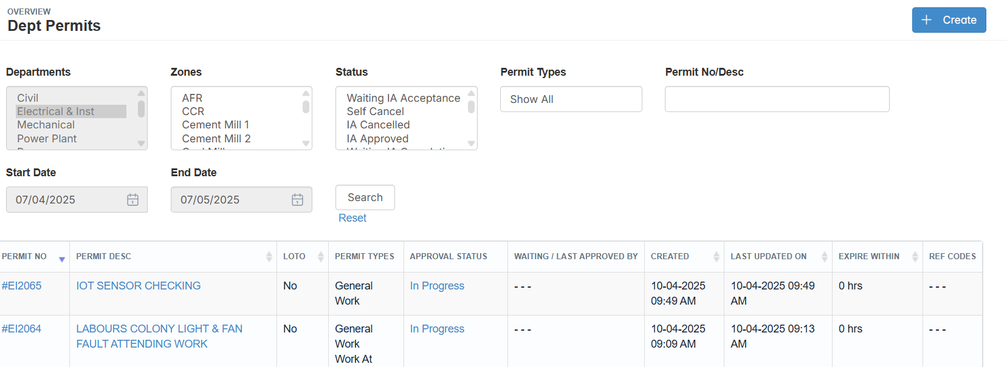
DEPT PERMITS
A Department Permit is a formal approval issued by a specific department, granting permission to carry out particular tasks, work activities, or equipment use within its area of responsibility. It ensures that departmental safety protocols, operational requirements, and risk controls are reviewed and authorized before the work begins.

Slide 6
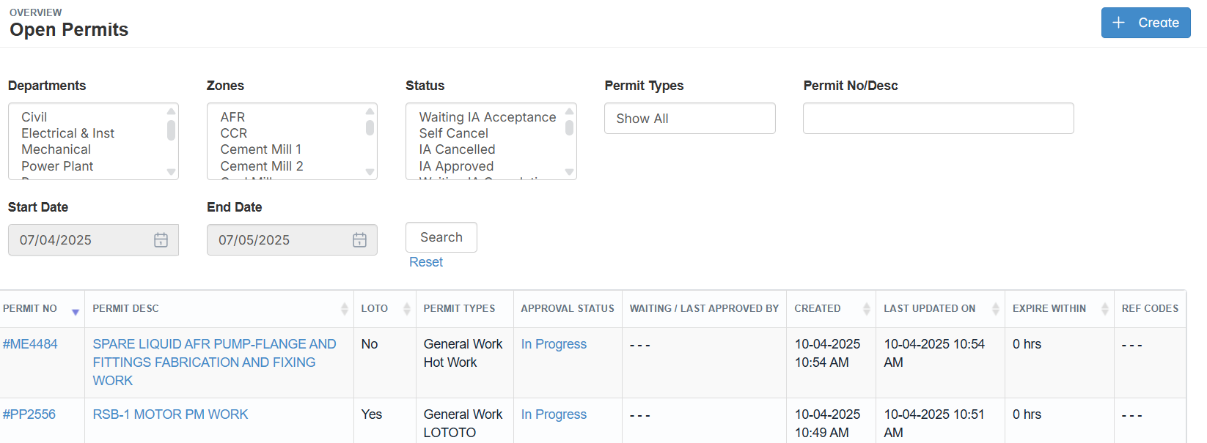
OPEN PERMITS
An Open Permit is a type of work authorization that remains valid for an extended period, allowing repetitive or routine tasks to be performed without issuing a new permit each time. It is typically used for low-risk activities and includes clearly defined scope, conditions, and safety controls to ensure ongoing compliance.

Slide 7
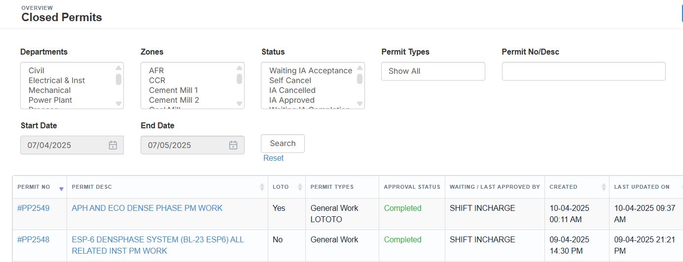
CLOSED PERMITS
A Closed Permit is a work authorization that has been completed, verified, and officially closed after the permitted task is finished. It confirms that all work is done safely, equipment and area have been restored to normal conditions, and all necessary checks and sign-offs are completed.

Slide 8
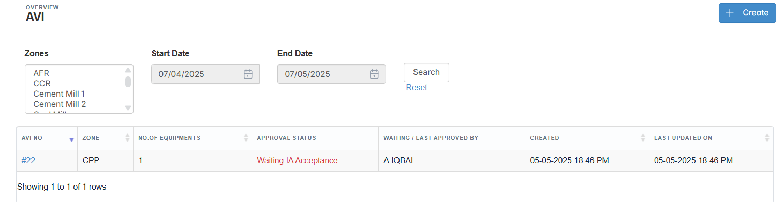
AVI
AVI is a critical step in the Permit to Work process, where the work area is physically inspected before, during, or after work to ensure it meets all safety requirements.

Slide 9
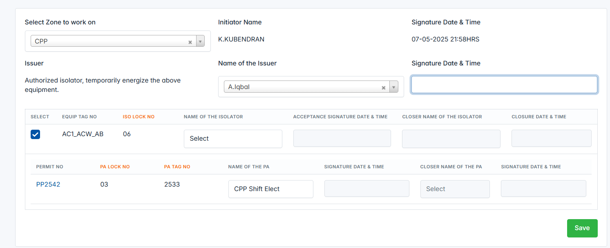
The purpose is to verify that:
1. The area is safe for work to begin
2. All hazards are identified and controlled
3. Safety measures (like barricades, signage, isolation, etc.) are in place
4. The area is clean and safe after work completion (for closing the permit)

Slide 10
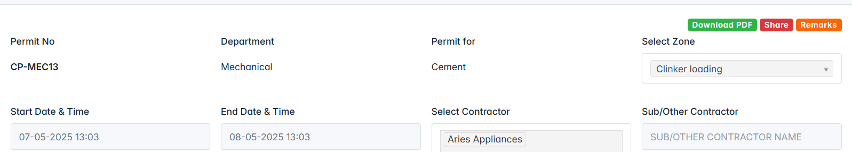
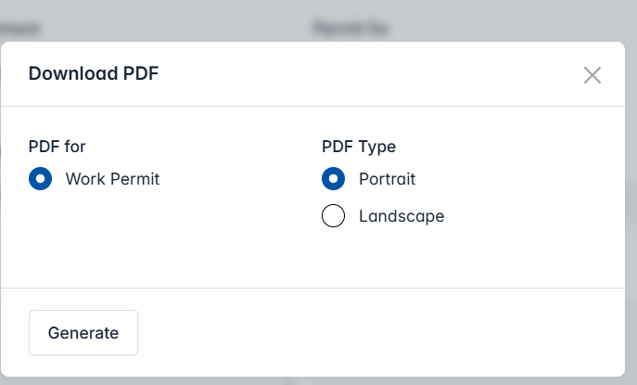
DOWNLOAD PERMITS WORK
Click the Download PDF button. And then the pop-up box appears on the screen. Select any type of PDF and click the generate button.

Slide 11
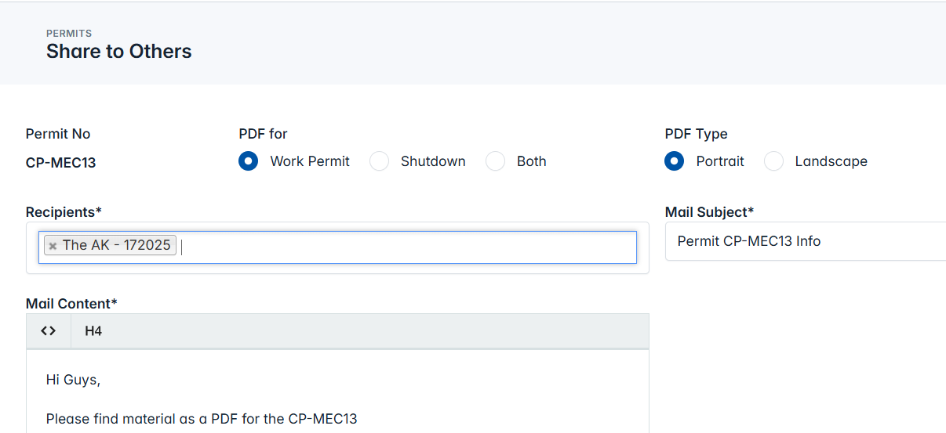
SHARE THE PERMITS WORK
Click the share button.
Then add the recipients to whom you have to send on and select any type of PDF.
Click the send button.

Slide 12
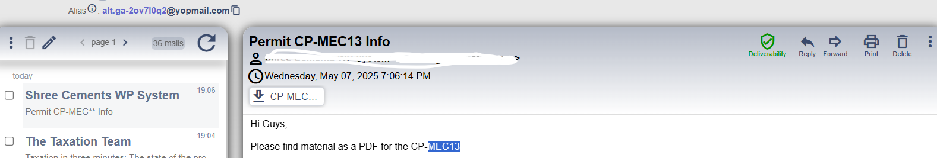
SHARE THE PERMITS WORK
The mail sent the respective person with pdf.

Slide 13
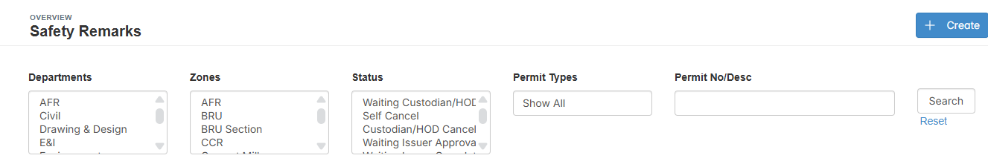
REMARKS THE PERMITS WORK
Safety remarks are specific notes or instructions written on a permit to highlight key safety precautions, potential hazards, or special requirements related to the work activity. These remarks ensure clear communication and reinforce safety expectations for all involved personnel.

Slide 14
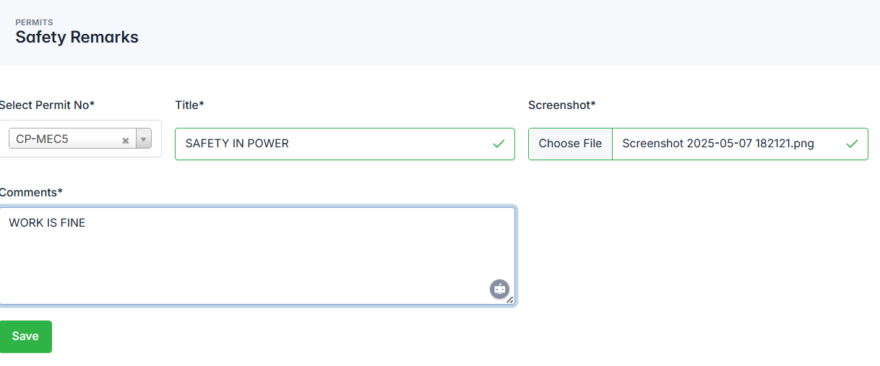
REMARKS THE PERMITS WORK
Click the create button to add the safety remarks for the particular permit id using the title, screenshots, and comments.
Then click the save button

Slide 15
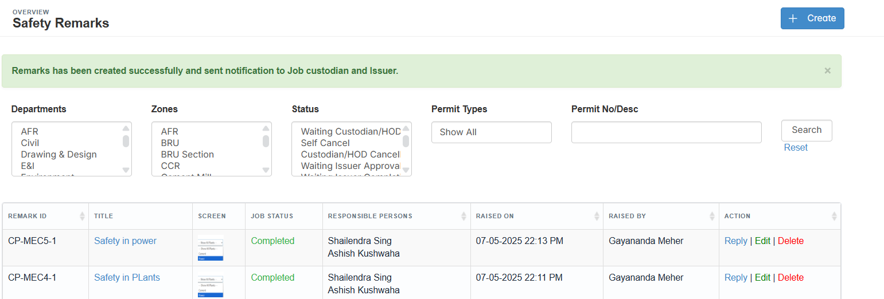
REMARKS THE PERMITS WORK
The remark has been successfully added to the table.
After that, if you need to, you can edit, delete, or reply

Slide 16
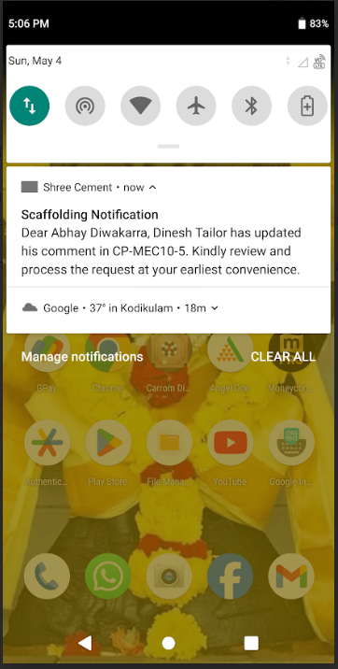
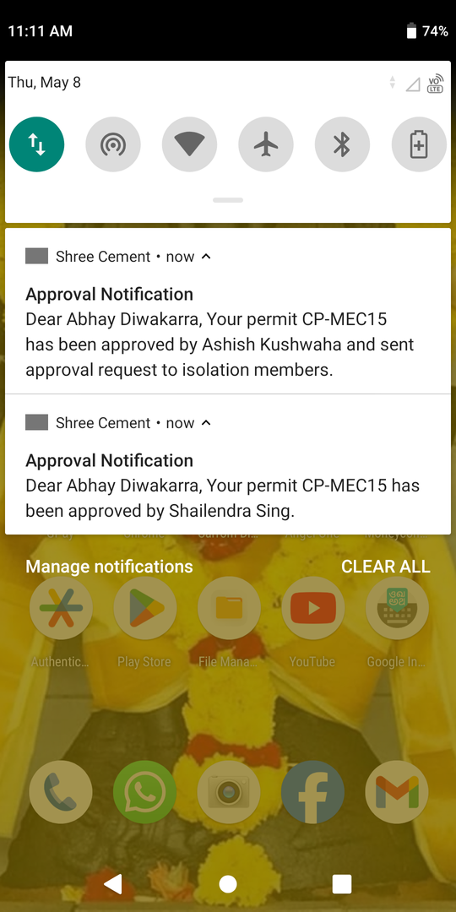
IN MOBILE APP
All core features available in the desktop version are fully accessible on the mobile app.
Users can receive real-time notifications directly on their mobile devices for approvals, updates,
Ensures flexibility and on-the-go access to the Permit to Work system anytime, anywhere.
Fingerprint authentication is enabled for secure and quick access.
Designed for on-the-go convenience without compromising security or control.

Slide 17
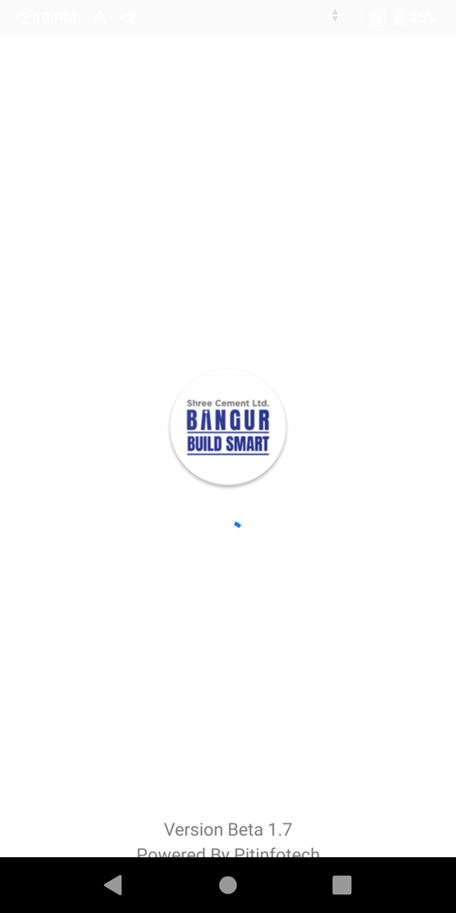
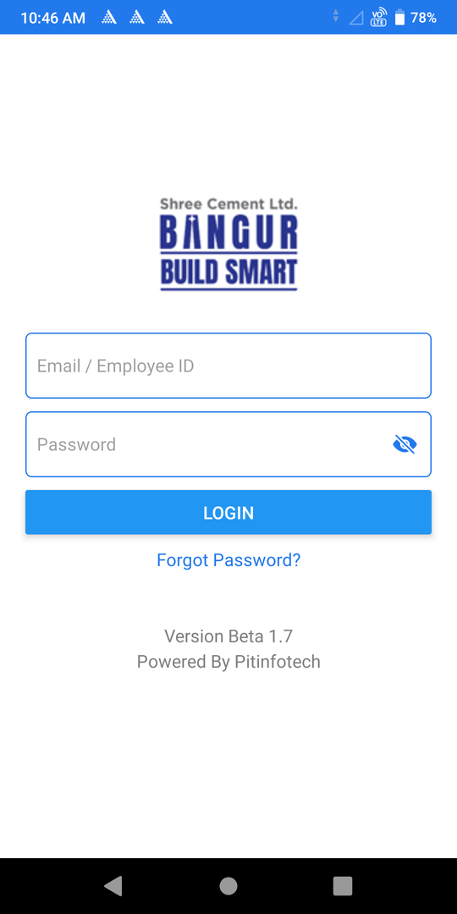
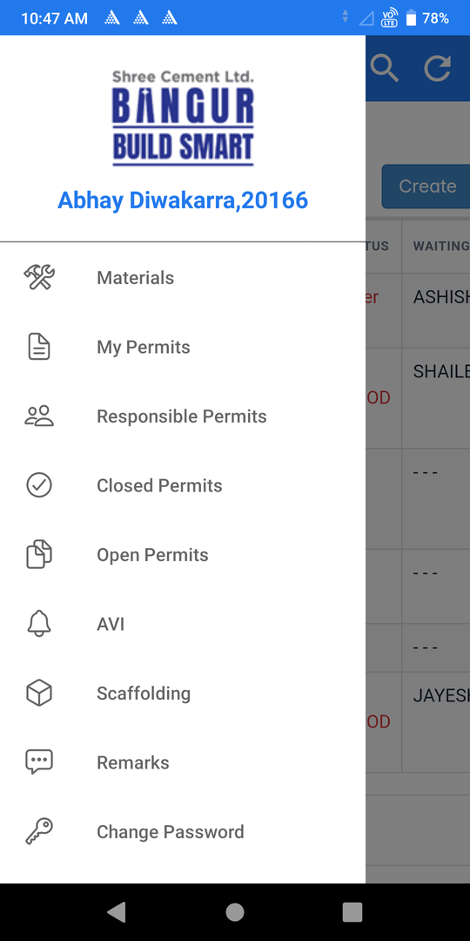
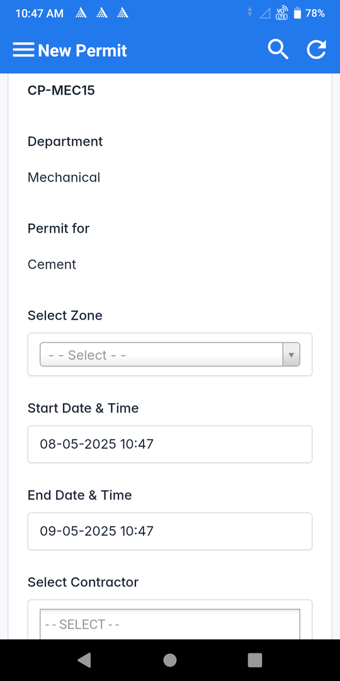
Some of the screenshots of the mobile app

Slide 18
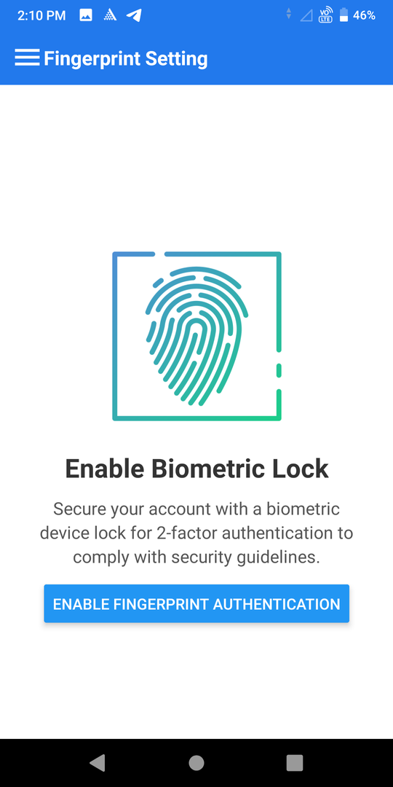
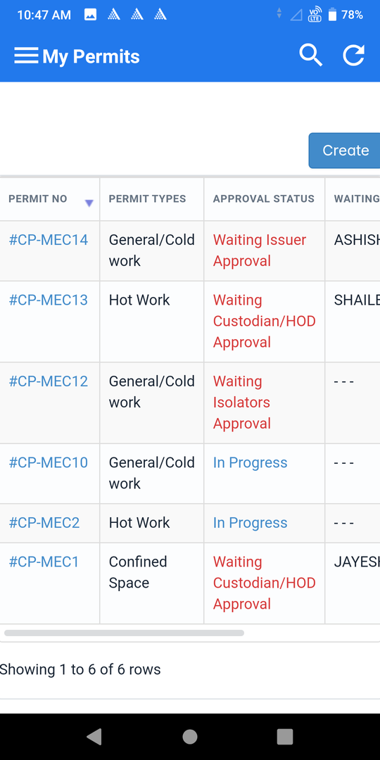
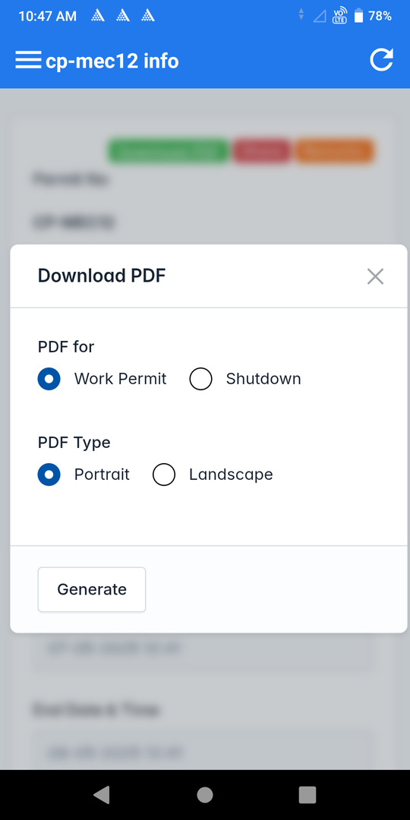
Some of the screenshots of the mobile app

Slide 19




Thank You for Engaging With Us
We appreciate your engagement and look forward to your feedback on the PTW system. For any inquiries, please reach out to our support team.
+91 9043371538
info@pitinfotech.com

